Slide 1
GPGPU Pipeline Visualization for RISC-V SIMT Architecture
CARRV 2024
Yu-Yu Hsiao†, Liang-Chou Chen, Chung-Ho Chen
National Cheng Kung University, Taiwan
†n28111534@gs.ncku.edu.tw

Slide 2
Outline
Motivation
RISC-V-based GPGPUs
Pipeline Visualization for CPUs
Pipeline Visualization for RISC-V SIMT Architecture
Enabling SIMT Execution Model on RISC-V
Case Studies

Slide 3
RISC-V-based GPGPUs
Simty (CARRV 2017)
Dynamic inter-thread vectorization
FPGA prototype
Written in synthesizable VHDL
Vortex (CARRV 2019, MICRO 2021)
LLVM-based software stack for OpenCL
Texture and graphic support
FPGA prototype
Written in synthesizable SystemVerilog
Incorporates a cycle-level simulator (C++)
GPGPU architecture exploration for CUDA:
GPGPU-Sim (ISPASS 2009)
Accel-Sim (ISCA 2020)

Slide 4
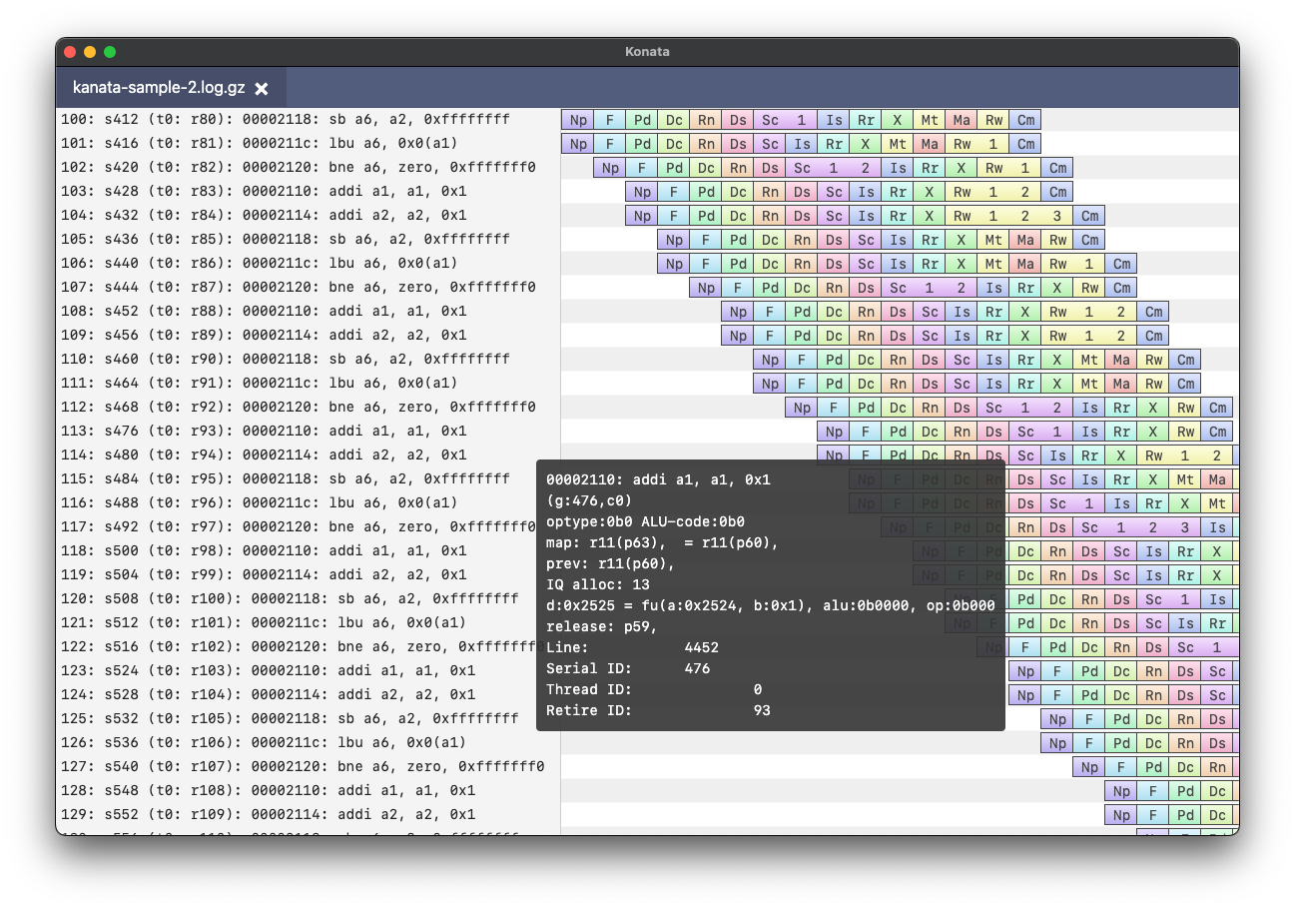
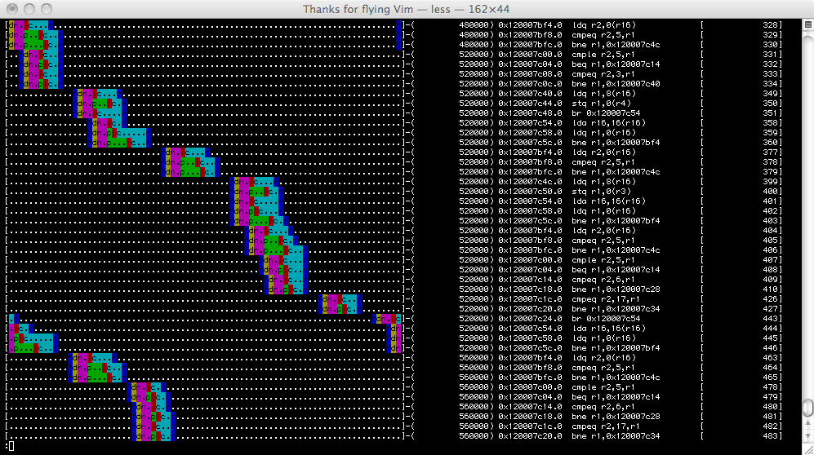
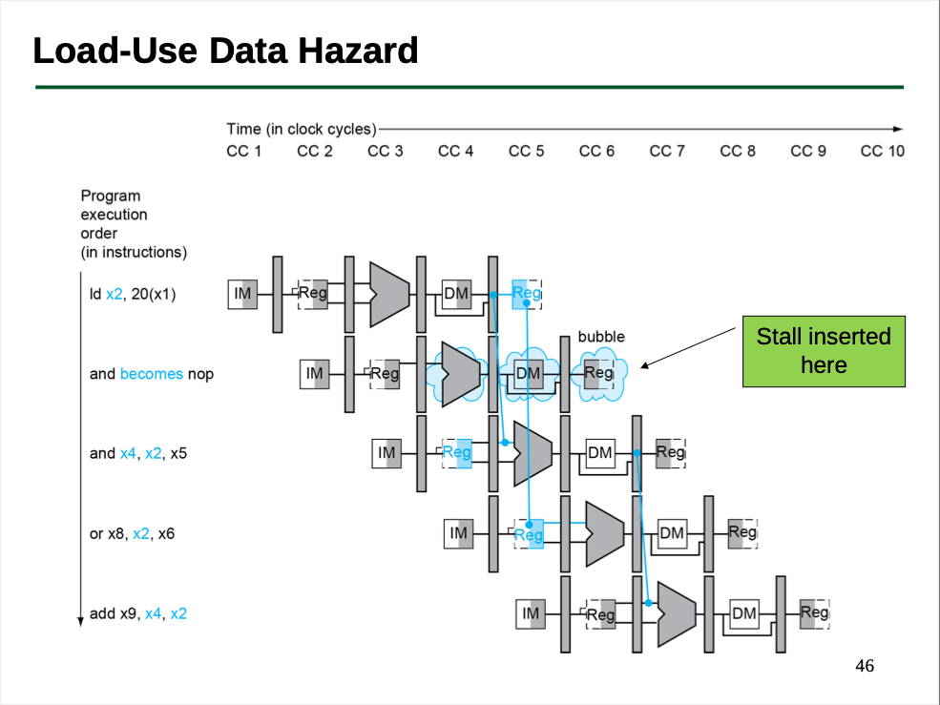
Pipeline Visualization for CPUs (1/2)
Pipeline visualization has become a well-established technique in the CPU architecture domain
gem5 text-based pipeline view, AndesClarity, Konata

Slide 5
Pipeline Visualization for CPUs (2/2)
Example: Dhrystone running on a RISC-V out-of-order superscalar processor, RSD¹
Superscalar pipeline: Two instructions are executed simultaneously at the same stage
Out-of-order execution: Instructions are executed out of program order
In-order fetch and retirement: Despite being executed out-of-order, the instructions are fetched and committed in the program order
¹https://github.com/rsd-devel/rsd

Slide 6
SPMD on SIMT Machine
// tid $∈$ [0,N)
C[tid] = A[tid] + B[tid];
time
Scalar inst.
Load
Load
Warp 0 at PC X
Assume:
thread/warp = 32
iteration/thread = 1
Load
Load
Add
Add
…
Store
Store
iter. 0
iter. 1
Warp: A set of threads that executes the same instruction (i.e., at the same PC)

Slide 7
SPMD on SIMT Machine
// tid $∈$ [0,N)
C[tid] = A[tid] + B[tid];
time
Scalar inst.
Load
Load
Warp 1 at PC X
Assume:
thread/warp = 32
iteration/thread = 1
Load
Load
Add
Add
…
Store
Store
iter. 32
iter. 33
Warp: A set of threads that executes the same instruction (i.e., at the same PC)
All warps in a SIMT machine are scheduled and executed seamlessly in a fine-grained multithreaded pipeline

Slide 8
The Branch Divergence Issue
Each thread can have conditional control flow instructions
Threads in the same warp can execute different control flow paths
Priority
Active Threads
SIMD
Utilization
// BB_0
if (tid % 2 == 0) {
// BB_1
} else {
// BB_2
}
// BB_3
BB_0
BB_1
BB_2
BB_3

Slide 9
ICS-First Re-convergence Scheme¹
Idea: Give inner conditional statements a higher priority
Faster threads will pause and wait for reconvergence at the outer statement due to priority degradation
Priority
Active Threads
SIMD
Utilization
// BB_0
pri_raise();
if (tid % 2 == 0) {
// BB_1
} else {
// BB_2
}
pri_lower();
// BB_3
BB_0
P0
100 %
BB_1
50 %
P1
BB_2
50 %
BB_3
P0
100 %
pause
re-converge
¹Kuan-Chung Chen and Chung-Ho Chen. 2018. Enabling SIMT Execution Model on Homogeneous Multi-Core System. ACM Transactions on Architecture and Code Optimization, 15, 1, (Mar. 22, 2018), 6:1–6:26. doi: 10.1145/3177960.

Slide 10
Proposed ISA Extension for our GPGPU
We employ ICS-First algorithm to handle branch divergence
3 additional instructions using custom-1 opcode
Patched LLVM compiler for inserting priority adjustment instructions automatically
fsa.pri.raise
fsa.pri.lower
fsa.pri.reset

Slide 11
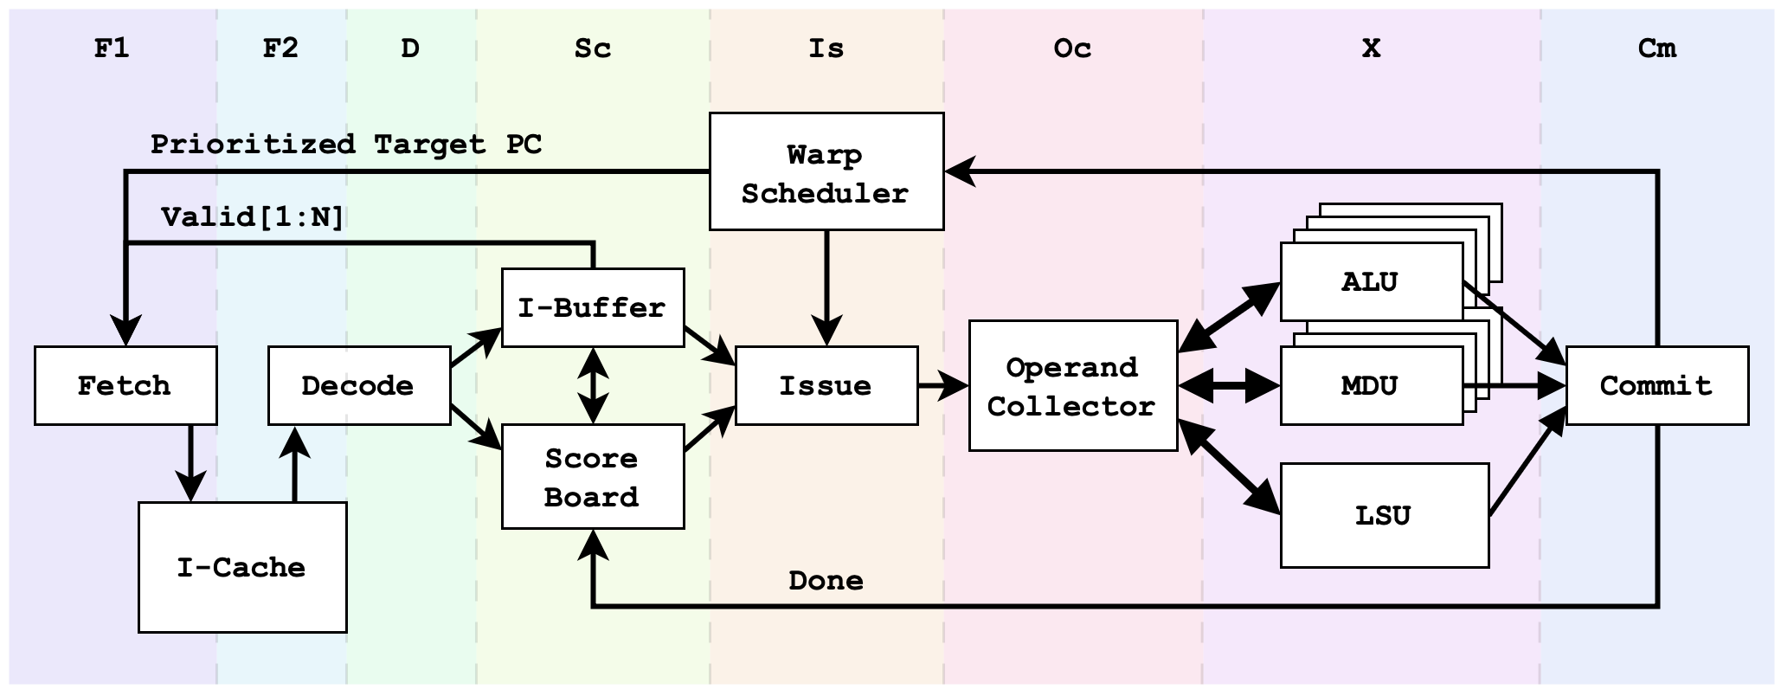
RISC-V SIMT Pipeline Architecture
Microarchitecture of modeled SM
Based on the architecture of GPGPU-Sim and CASLab-GPU¹
8-stage in-order issue OoO commit pipeline, priority-based PC arbitration
Dedicated fetch scheduler
¹Y. -X. Su, J. -H. Jheng, D. -J. Chen and C. -H. Chen, "Development of an Open ISA GPGPU for Edge Device Machine Learning Applications," 2019 Eleventh International Conference on Ubiquitous and Future Networks (ICUFN), Zagreb, Croatia, 2019, pp. 214-217, doi: 10.1109/ICUFN.2019.8806196.

Slide 12
Pipeline Visualization Workflow
We implement a cycle-based RISC-V SIMT simulator
Run execution-driven simulation on a compiled SPMD program
Logs are dumped during the simulation
Open and render the pipeline trace in Konata pipeline viewer
Kanata 0004
C= -1
C 1
I 0 0 0
S 0 0 F1
I 1 0 0
S 1 0 F1
C 1
I 2 0 0
S 2 0 F1
I 3 0 0
S 3 0 F1
C 1
C 1
...
Log size:
w/o compression: 200 bytes per instruction
w/ compression (gz): 40 bytes per instruction
Kanata Log Format

Slide 13
Pipeline Visualization for SIMT Architecture (1/2)
In SIMT, instructions in the pipeline may belong to different warps
Use different colors to identify the warp ID of the instruction
To trace the execution of individual instructions throughout the pipeline
Use different colors to identify the pipeline stage (just as CPUs)

Slide 14
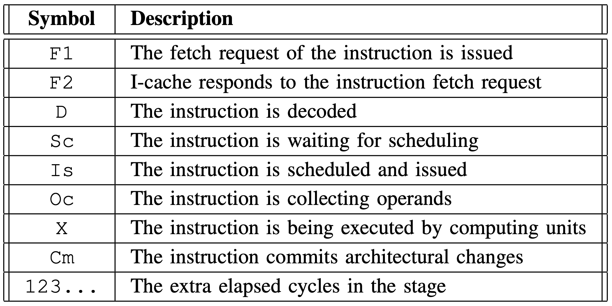
Pipeline Visualization for SIMT Architecture (2/2)
Meaning of the generated pipeline trace color scheme and symbol

Slide 15
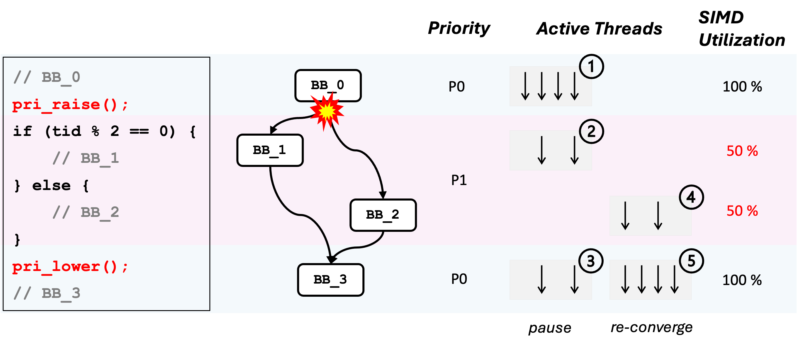
Case Study (1/3): Handling Control Divergence
We reproduce the situation mentioned earlier with the assembly code
Branch taken: BB_1
Not taken: BB_2
.section .text
.global main
main:
bb0:
csrr a0, 0xfe2 # read tid
andi a0, a0, 1 # tid % 2
fsa.pri.raise
beqz a0, bb1
bb2:
slli a0, a0, 1
j bb3
bb1:
addi a0, a0, -1
bb3:
fsa.pri.lower
ret

Slide 16
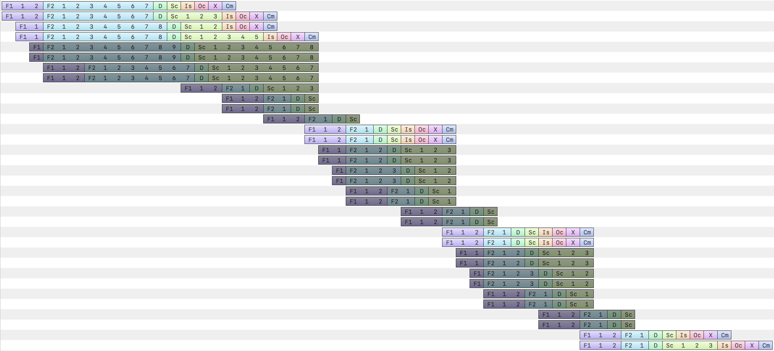
Case Study (1/3): Handling Control Divergence
Flushed instructions
control dependency

Slide 17
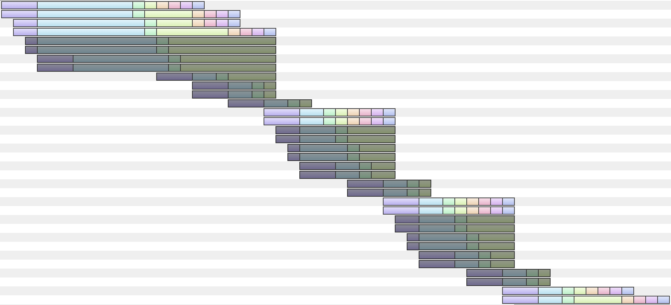
Case Study (1/3): Handling Control Divergence
BB_0
control dependency

Slide 18
Case Study (1/3): Handling Control Divergence
Threads in the same warp diverged
SIMD utilization rate: 50%
When reaching fsa.pri.lower, the execution pauses and resumes at the other divergent path
BB_1 -> BB_3
diverged!
control dependency

Slide 19
Case Study (1/3): Handling Control Divergence
SM continues to execute the other divergent path
Threads in the same warp still diverged (with mask inverted)
BB_2
control dependency

Slide 20
Case Study (1/3): Handling Control Divergence
All threads now share the same priority (P0), resulting in re-convergence
BB_3
control dependency
re-converge

Slide 21
Case Study (1/3): Handling Control Divergence
ICS-First algorithm handles branch divergence effectively
Control dependencies have a great impact on performance
SIMT processor should be able to hide the latency of control flow changes by proactively scheduling distinct warps for execution
control dependency

Slide 22
Case Study (2/3): Latency Hiding Through TLP
Stream Multiprocessors (SM) utilize concurrency to hide latencies
If one warp stalls, the SM can efficiently use fine-grained multi-threading to switch to another warp
Higher Thread-Level Parallelism (TLP)
GTO: Greedy-Than-Oldest
ref: https://dl.acm.org/doi/10.1145/2807591.2807598

Slide 23
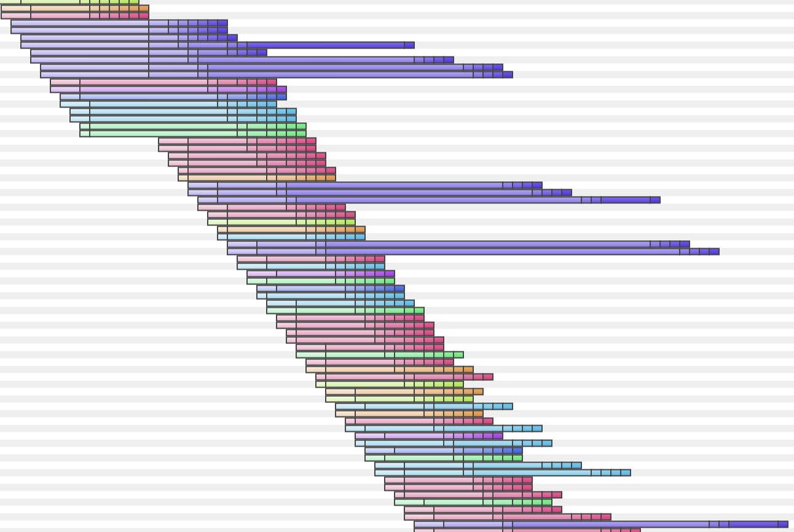
Case Study (2/3): Latency Hiding Through TLP
Demo: A load-use-store code snippets
Configuration:
8 warps per core
4 threads per warp
GTO scheduler
data dependency
data dependency
Latency hiding by scheduling other warps for execution (high TLP)
data dependency

Slide 24
Case Study (2/3): Latency Hiding Through TLP
Demo: A load-use-store code snippets
Configuration:
2 warps per core
16 threads per warp
GTO scheduler
data dependency
Latency is exposed and stalls the pipeline (low TLP)

Slide 25
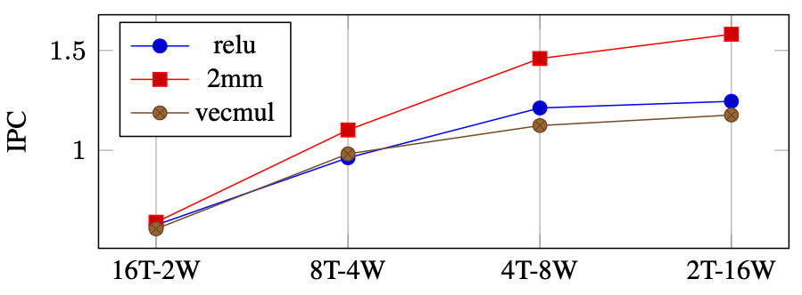
Case Study (2/3): Latency Hiding Through TLP
Demo: A load-use-store code snippets
The slope of the trace roughly indicates the IPC performance
Steeper: Instructions are issued and committed more frequently (higher IPC)
Flatter: Pipeline is stalled due to the presence of long-latency instructions (lower IPC)

Slide 26
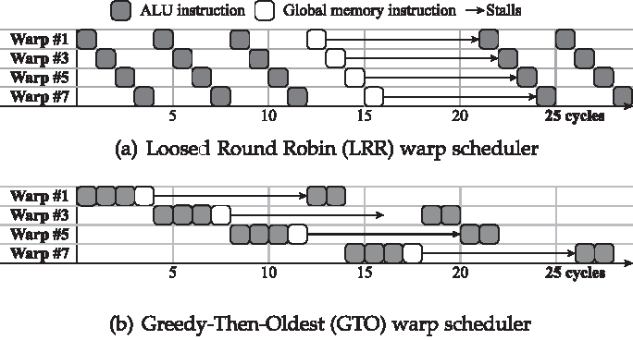
Case Study (3/3): LRR & GTO Scheduling Policies
Loosely Round Robin (LRR)
Warps are prioritized for scheduling in round-robin order
“Loosely”: If a warp cannot issue during its turn, the next warp in round-robin order is given the chance to issue
Greedy-Then-Oldest (GTO)
Prioritizes the execution of a single warp until it encounters a blocking latency event

Slide 27
Case Study (3/3): LRR & GTO Scheduling Policies
We run the same workload with LRR and GTO
GTO: The load-use-store program hotspot is scattered
LRR: All warps reach the hotspot concurrently
Configuration:
4 warps per core
8 threads per warp
GTO scheduler
Hotspot of warp 0
warp 1
Hotspots occur concurrently
warp 2 & 3

Slide 28
Case Study (3/3): LRR & GTO Scheduling Policies
The concurrent occurrence of program hotspots can potentially stall the pipeline (workload: 2mm)
The execute stage becomes congested
Long-latency instructions are temporally separated
Instructions cannot be issued due to the stall

Slide 29
Conclusion and Future Work
Pipeline visualization is also helpful for SIMT architectures
Architecture exploration
Performance bottleneck analysis
Education in computer architecture
Rendered pipeline trace can serve as a reference model for RTL implementations
Validate the behavior of the implementation
Improve the accuracy of the cycle-based model
Integration to SOTA GPU simulation platforms (Accel-Sim)

Slide 30
Thank you!

